Slide 1
Unit Test
Unit Test is a test that is done typically by the developer himself or herself after he or she has finished writing a piece of code.
The Unit test requires writing of test cases, test suits and running tests to document the result as desirable or undesirable.
The goal of unit testing is to isolate each part of the program and show that the individual parts are correct
This tests can be either manual or automatic.
It is not Automated GUI tester.
It is not a scripting language, all test are written in .NET supported language e.g. C#, VC, VB.NET, J# etc.

Slide 2
Unit testing features in Visual Studio
Visual Studio allows the developers create and run unit tests. Unit test frameworks are used by the Visual Studio to do this.
MSTest is a framework that comes with Visual Studio. But NUnit, which is also another framework that is widely used.
This also be configured with Visual Studio and used.
Visual Studio Test Explorer is used for unit testing.

Slide 3
NUNIT
It is a testing framework for .NET.
Nunit Framework is a part of Junit framework from Java.
Nunit Framework is an open source product.
It is written in C#.
It uses an Attribute based programming model.

Slide 4
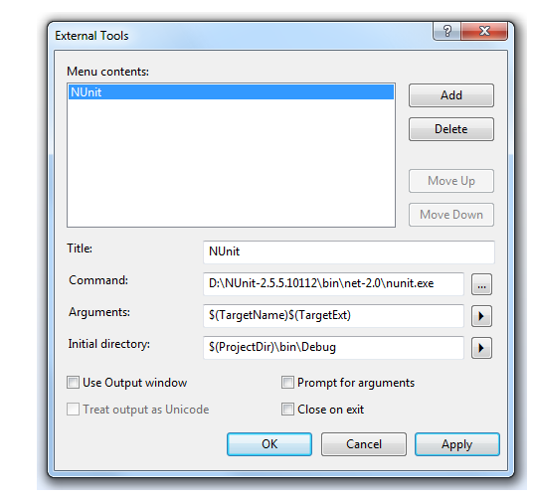
Activity: Setting NUnit in VS 2010
Download and install NUnit-2.6.1(Nunit 2.5.5 or above)
Make sure that you have Expert Setting enabled by going to Tools - Settings -Expert Settings.
Select Tools -External Tools.

Slide 5
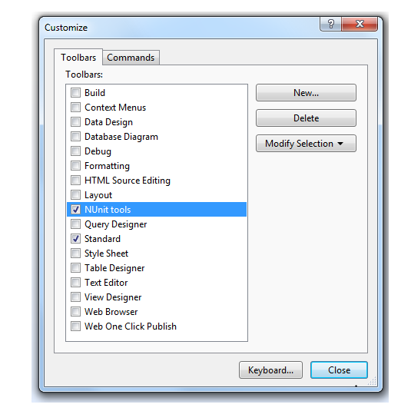
Activity: Setting NUnit in VS 2010
Select View -Toolbars -Customize

Slide 6
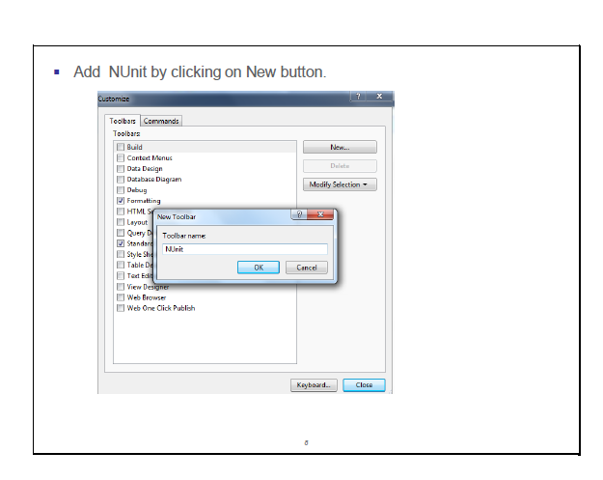
Activity: Setting NUnit in VS 2010

Slide 7
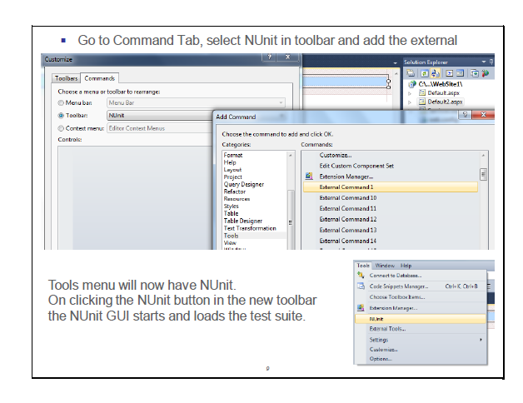
Activity: Setting NUnit in VS 2010

Slide 8
Implementing the Unit Test
Creation of unit test involves writing many Test classes
A test class may be in application assembly, or A separate test assembly.
Things to note are:
Import NUnit.Framework namespace.
The NUnit uses [TestFixture] attribute to indicate the test class and [Test] to indicate the method that is

Slide 9
NUNIT
public class Calculate
{
public int Result;
public void Add(int a, int b)
{
Result=a + b;
}
static void Main()
{
Calculate ob = new Calculate();
ob.Add(2, 3);
Console.WriteLine("Result " + ob.Result);
Console.ReadKey();
}
}

Slide 10
NUNIT
[TestFixture]
public class TestCalculate
{
[Test]
public void CalculateTest()
{
Calculate c = new Calculate();
c.Add(2, 3);
Assert.AreEqual(5, c.Result);
}
}

Slide 11
NUNIT
Assertions are the way to test for fail-pass test.
NUnit framework support following assertions:
Assert.
AreEquals()
IsNotNull()
IsNull()
IsTure()
IsFalse()
GreaterOrEqual()

Slide 12
NUNIT
You can use as many Assert statements in a method as you like.
However, NUnit framework, will show a method as failed if even a single assertion fails, as expected.
But what is important to remember is that if first assertion fails, next assertion will not be evaluated, hence you will have no knowledge about next assertion.
Therefore it is recommended that there should only be one Assertion statement per test method. If you believe there should be more than one statement, create a separate test case method.

Slide 13
NUNIT
What Should Be Tested?
Test for boundary conditions, e.g. our Calculator class only multiply signed integers, we can write a test for multiplying two big numbers and make sure our application code handles it.
Test for both success and failure.
Test for general functionality.

Slide 14
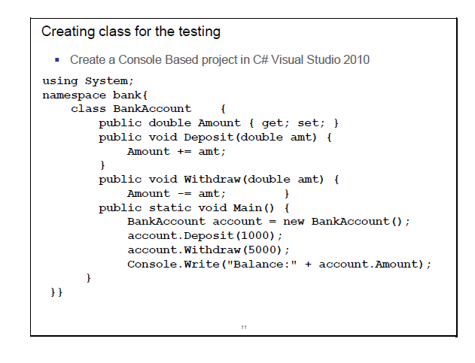

Slide 15
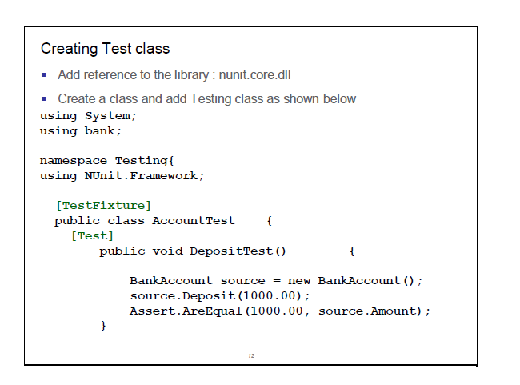

Slide 16
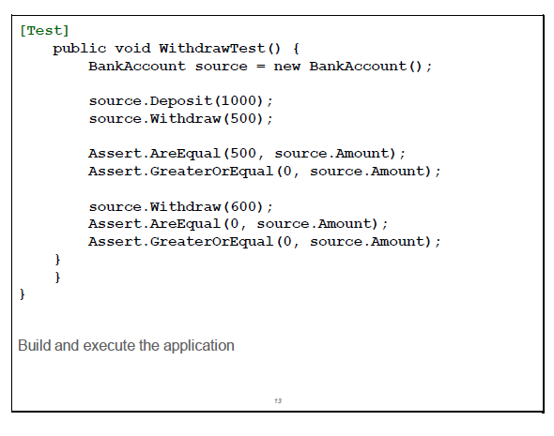

Slide 18
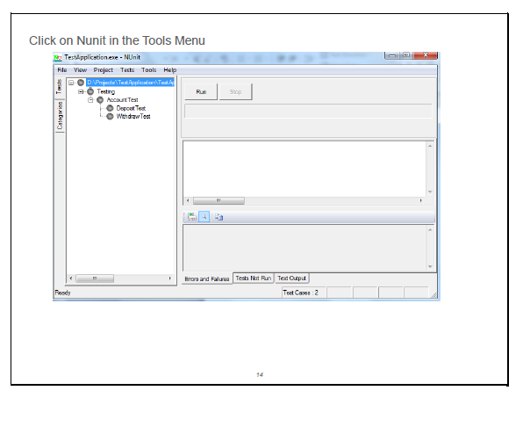

Slide 19
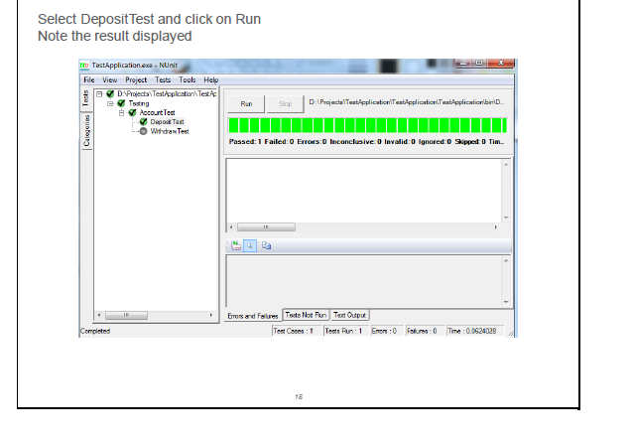

Slide 20
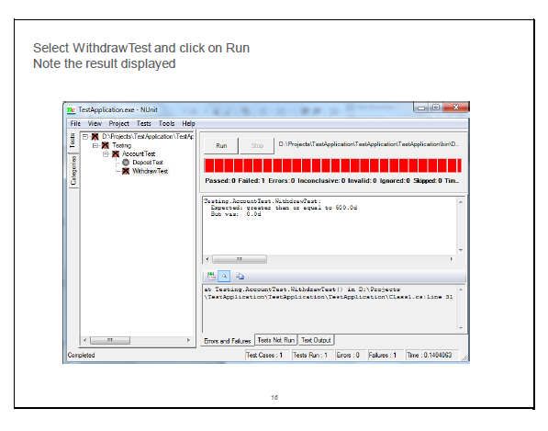

Slide 21
NUNIT
The Naming Convention and Standards
As discussed above all test cases should go in a separate assembly. A suggested name for such assembly is [CodeAssembly].UnitTests.dll e.g. UnitTestApplication.UnitTests.dll
You should follow the naming rule defined in .NET Framework SDK. A good tool to use is FxCop to force the naming convention.
This assembly should have at minimum one-to-one relation between methods and test methods.
Test case name should be Test_[MethodToBeTested][SomeAttribute] e.g. Test_Add, Test_AddFailure.

